Slide 1

WEB – BASED CHAT APPLICATION
MEMBER –
NAME | SECTION | UID
Shubham Bawankar | ON20BCS-715 B | 20BCS7409

Slide 2
Introduction
The project “Web – Based Chat Application ” is a web based project which mainly focuses on basic operation like creating new users account through signup page then let them access their account through their credentials. Searching for another user through user user id and transmitting message to each other by abstraction the details from other user. It helps user to check the status of person whether the user is online or offline and status of message like whether it is been read or not , or time at which it is been send or received.

Slide 3
Aim & Objective
SMS related issues.
Space issue in device.
Checking for receiver status whether online or offline
Message status whether read or unread
Also requires less time and faster service
Secure data transmission
Easily accessible

Slide 4
TECHNOLOGY USED
LANGUAGES USED
HTML
CSS
JS
PHP
BOOTSTRAP
TOOLS USED
VS code
XAMPP
Window 10 OS

Slide 5
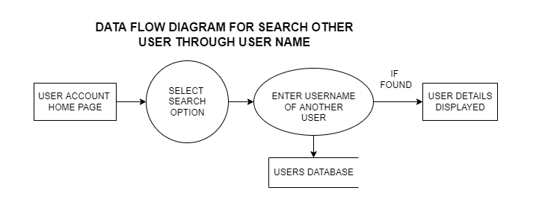
Data Flow Diagram

Slide 6
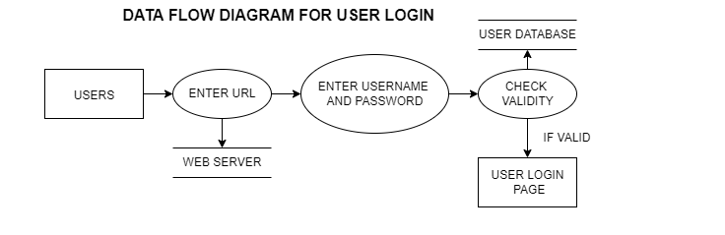
Data Flow Diagram

Slide 7
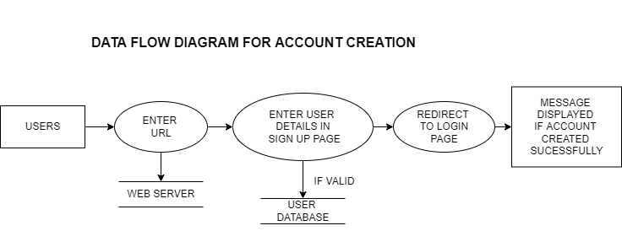
Data Flow Diagram

Slide 8
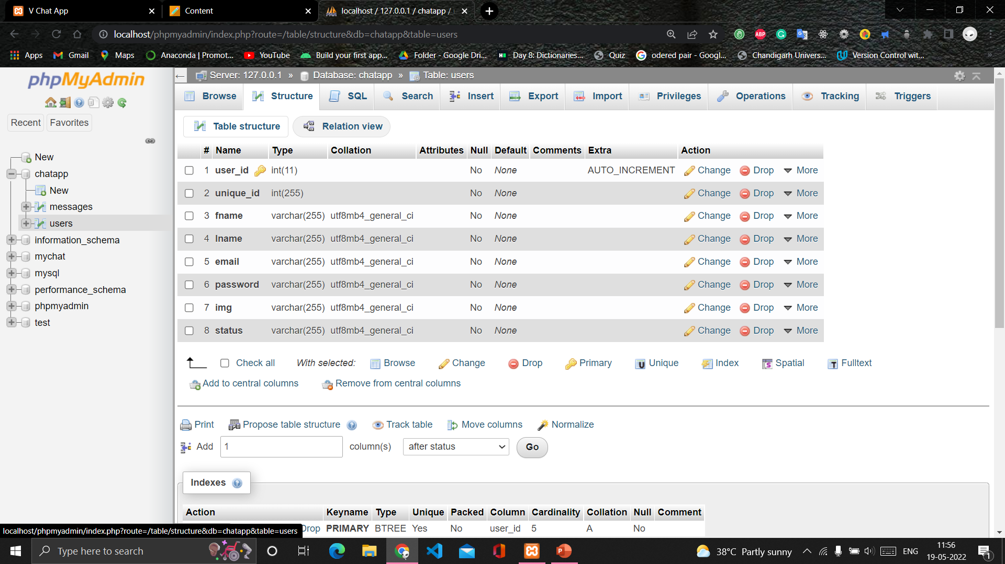
Back End Database - Login and Signup table structure

Slide 9
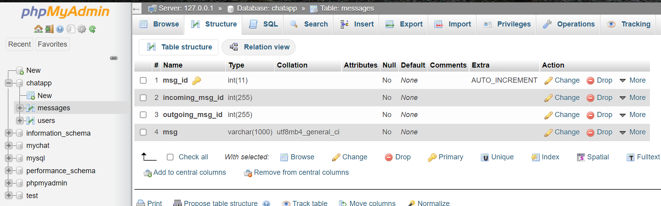
Back-End Database - Users Chat Data table

Slide 10
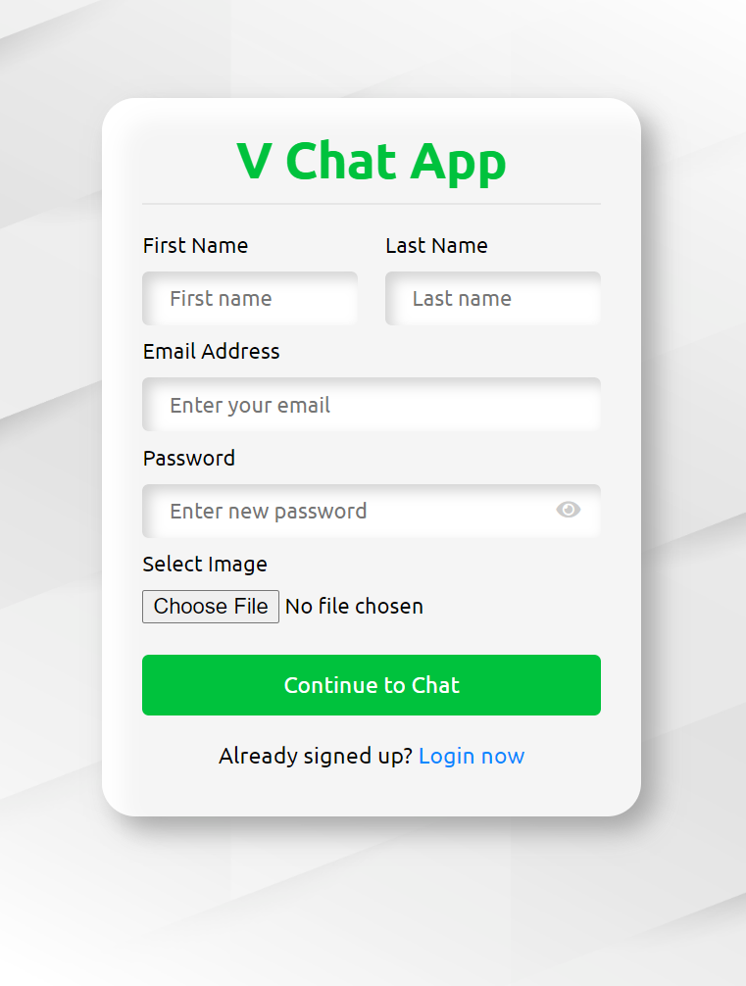
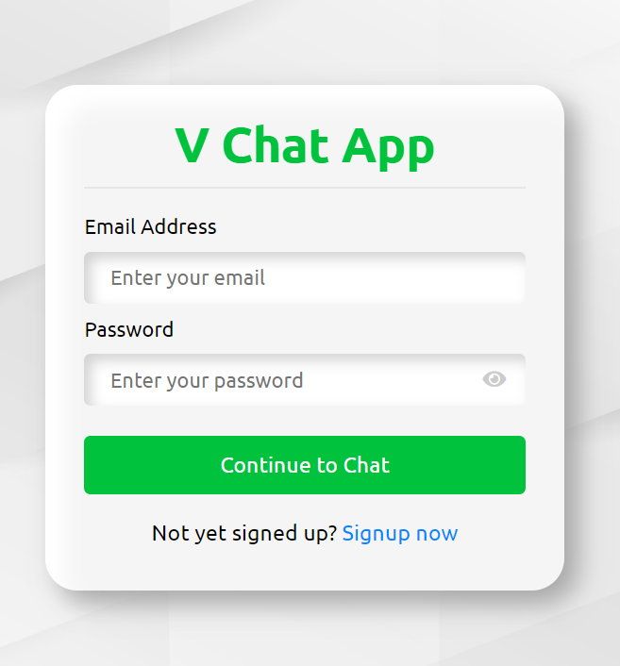
Screenshot of web app

Slide 11
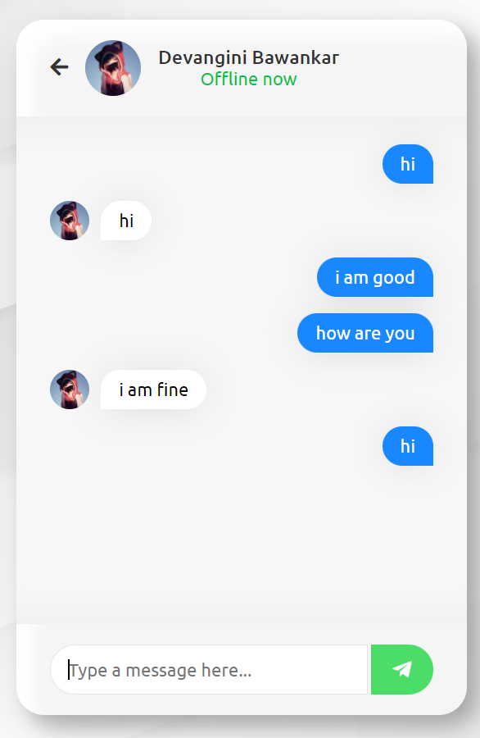
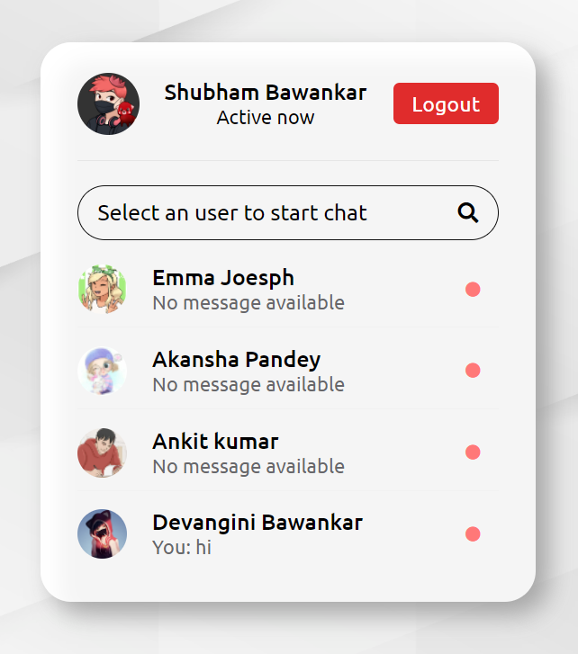
Screenshot of web app

Slide 12
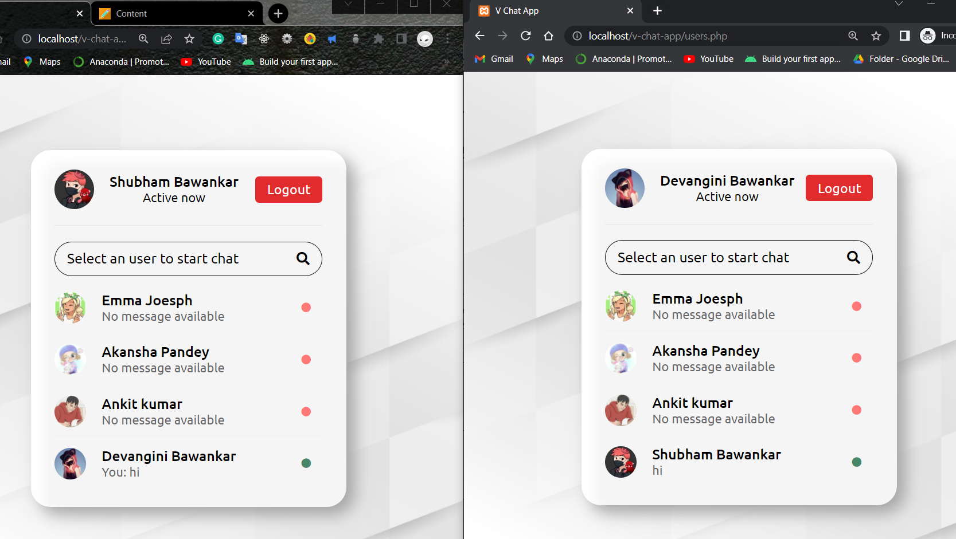

Slide 13
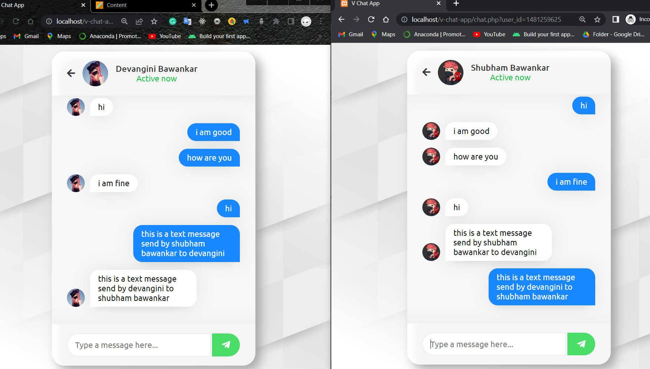

Slide 14
Contribution
Shubham Bawankar - 20BCS7409
Worked on front end and web designing part. Worked on designing using HTML, CSS, JavaScript, and Bootstrap.
Worked on database creation and all backend coding part in project.

Slide 15
Outcome
Advantage
More efficient for users to communicate easily.
Low operation cost and better and quality services.
No issue related to space issue in device.
Can be use anywhere with internet connectivity.
Disadvantage
Not everyone is has proper internet connection.
Chat is stored in database in text format so less secure.

